Slide 1
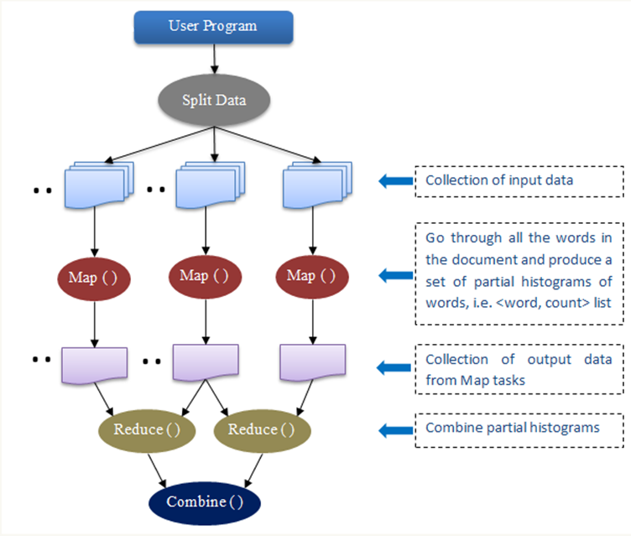
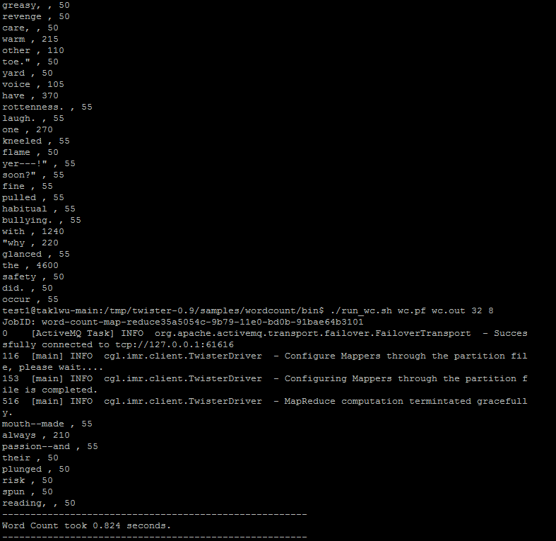
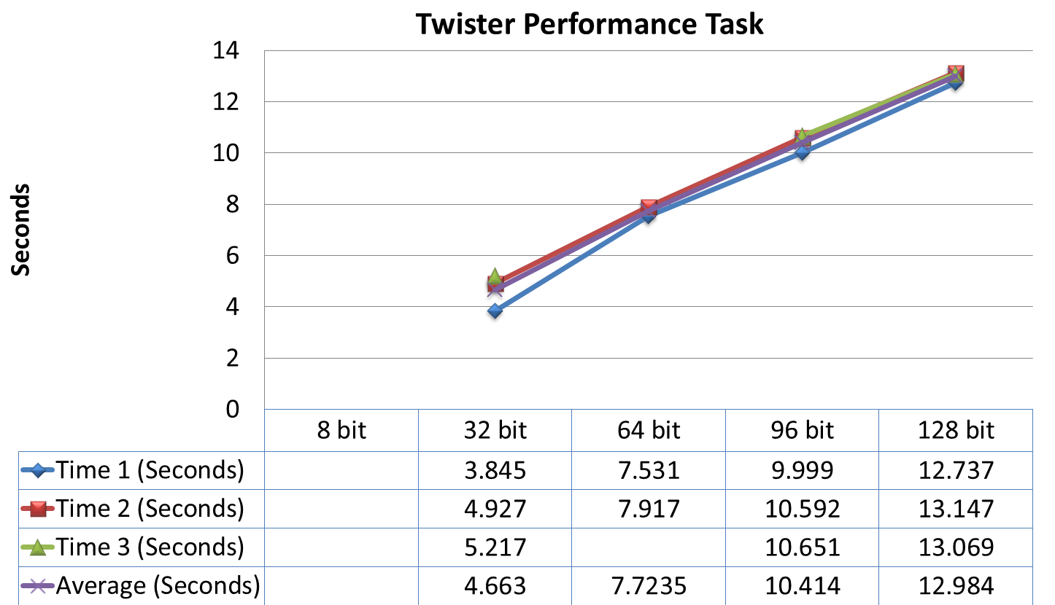
Members: Joyce Bevins and Autumn Luke
Mentors: Thilina Gunarathne, Stephen Wu, and Bingjing Zhang
Abstract
Twister vs. Hadoop
The primary focus of this research project was to analyze the attributes of MapReduce frameworks for data intensive computing and to compare two different MapReduce frameworks, Hadoop and Twister. MapReduce is a data processing framework that allows developers to write applications that can process large sets of data in a timely manner with the use of distributed computing resources. One of it’s main features is the ability to partition a large computation in to a set of discrete tasks to enable of parallel processing of the computation. Google, the most popular search Engine on the internet, uses MapReduce to simplify data processing on it’s large clusters. We analyze the performance of Hadoop and Twister using the Word Count application and compare the scalability and efficiency of the two frameworks for this particular application.
Map Reduce Framework
Execution
1. Input 2. split 3. map 4. shuffle 5. Reduce 6. Result
an input reader
a Map function
a partition function
a compare function
a Reduce function
an output writer
Twister Performance test: The efficiency of Twister and Hadoop, was tested by running Word Count applications for both. First the Twister Framework was tested by increasing the bit size of a single file to observe the difference in the time it takes to complete the Word Count application. This process was executed four additional times using four different bits. An average was then calculated after three successful runs to obtain an accurate result of the time the application .
Results
Future Work
Future work will include applying the same test to the Hadoop Word Count application. After three runs are successfully completed for the Hadoop framework, an average will be calculated and compared with the average of Twister. For this purpose, the best average time will decipher which MapReduce framework can be utilized most efficiently.

